Slide 1

Harmonic Insights: Uncovering Spotify's Pricing Dynamics Piyush Kakde, Archita Ray, Ashvin Raj, Sahana Reddy, Akshita Sharma

Slide 2
Content
Team
Current Pricing Structure
Price Increase
Market Reaction of Price Increase
5. Conjoint Analysis
6. Recommendations
7. Future Scope & Biases
8. Conclusion

Slide 3
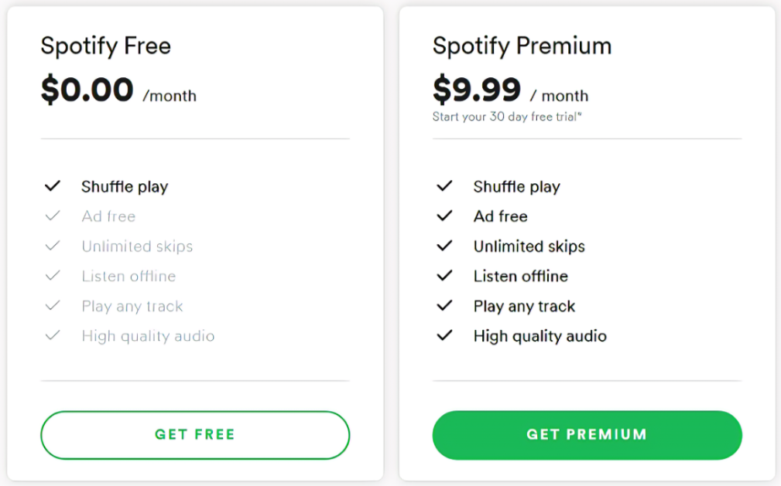
Problem Statement
Old
Premium
New
Premium
How can Spotify not only boost but sustain its market dominance?
$10.99 / month

Slide 4





Pricing
 | Spotify | Apple Music | Qobuz | Amazon Music Unlimited | YouTube Music
Free | $0.00 | 1 month | 1 month | No | with Youtube Premium
Individual | $10.99 | $10.99 | $10.83 | $9.99 | $10.99
Family | $16.99 | $16.99 | $16.67 | $15.99 | $14.99
Student | $5.99 | $5.99 | N/A | $0.99 | $5.49
US military discount | No | No | No | Yes | No
Spotify responds to changes in competitor pricing due to Anchoring Effect
Spotify and its competitors are following 2nd Degree and 3rd Degree Price Discrimination
Notes:
2nd degree segmentation
Pricing
Anchoring

Slide 5
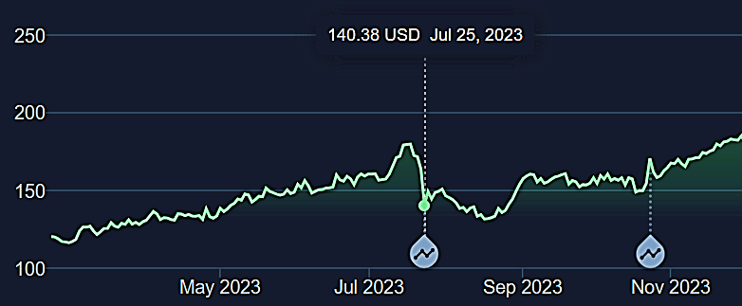
Effect of 10% Price Increase
Stock Price ($)
The stock prices dropped the day Spotify announced 10% increase in their subscription prices

Slide 6

Volume Up on Growth: Refining Spotify's Approach

Slide 7
Brand Name | Music Videos | Price $ | Podcasts | Offline Downloads/ Uploads
Amazon | No | 10.99 | Yes | No
Amazon | Yes | 9.99 | Yes | No
Amazon | Yes | 9.99 | No | Yes
Amazon | No | 10.99 | No | No
Amazon | No | 9.99 | Yes | Yes
Apple | Yes | 10.99 | No | No
Apple | No | 10.99 | Yes | No
Apple | Yes | 9.99 | No | Yes
Apple | No | 9.99 | Yes | Yes
Spotify | Yes | 10.99 | No | No
Spotify | Yes | 9.99 | Yes | Yes
Spotify | No | 10.99 | Yes | No
Spotify | No | 10.99 | No | Yes
Spotify | Yes | 9.99 | No | Yes

Slide 8
Conjoint Analysis : Features
 | Spotify | Apple Music | Qobuz | Amazon Music Unlimited | YouTube Music
Free trial period | 30 days | 30 days to 3 months | 30 days | 90 days | 30 days
Music library size | Over 100 million | Over 100 million | Over 100 million | 100 million | 100 million
Maximum bit rate | 320Kbps | 256Kbps, 1,152 Kbps (HD estimated) | 6,971Kbps | 256Kbps, 3,730Kbps (HD) | 256Kbps
Offline listening | Mobile and desktop | Mobile and desktop | Mobile and desktop | Mobile and desktop | Premium, mobile only
Radio stations | Yes | Yes | No | Yes | Yes
Podcasts | Yes | No | No | Yes | Yes
Music videos | Yes | Yes | No | No | Yes
Music locker functionality | No | Yes | No | No | Yes

Slide 9
Conjoint Analysis
Notes:
For Willigness To Pay
Spotify, the popular audio streaming service, has employed an interesting pricing strategy to cater to its diverse user base. Let's delve into the details:
1. Freemium Model: Spotify initially adopted a freemium pricing model. This approach allowed basic functionality for free, while charging users for additional features such as ad-free streaming and offline music downloads².
2. Localized Pricing Optimization: Spotify goes beyond setting fixed prices in local currencies. Instead, they use market research and data to optimize pricing for each local market. By tailoring prices to suit consumers in specific countries, they reduce customer friction and build trust³.
3. Premium Price Adjustments: In 2023, Spotify made changes to its Premium prices across several markets. Existing subscribers in the US and other countries were affected by these adjustments. Here are the new prices:
- Premium Individual: $10.99 per month
- Premium Duo: $14.99 per month
- Premium Family: $16.99 per month
- Premium Student: $5.99 per month¹
4. Four Premium Account Tiers: Spotify offers four premium plans based on individual needs:
- Premium Individual: For solo listeners.
- Premium Duo: Ideal for couples or pairs.
- Premium Family: Designed for families.
- Premium Student: Tailored for students⁴.
In summary, Spotify's pricing strategy combines a freemium approach with localized optimization, ensuring a wide reach and a seamless experience for music enthusiasts worldwide. 🎶🔊

Slide 10
Conjoint Analysis
Notes:
Spotify, the popular audio streaming service, has employed an interesting pricing strategy to cater to its diverse user base. Let's delve into the details:
1. Freemium Model: Spotify initially adopted a freemium pricing model. This approach allowed basic functionality for free, while charging users for additional features such as ad-free streaming and offline music downloads².
2. Localized Pricing Optimization: Spotify goes beyond setting fixed prices in local currencies. Instead, they use market research and data to optimize pricing for each local market. By tailoring prices to suit consumers in specific countries, they reduce customer friction and build trust³.
3. Premium Price Adjustments: In 2023, Spotify made changes to its Premium prices across several markets. Existing subscribers in the US and other countries were affected by these adjustments. Here are the new prices:
- Premium Individual: $10.99 per month
- Premium Duo: $14.99 per month
- Premium Family: $16.99 per month
- Premium Student: $5.99 per month¹
4. Four Premium Account Tiers: Spotify offers four premium plans based on individual needs:
- Premium Individual: For solo listeners.
- Premium Duo: Ideal for couples or pairs.
- Premium Family: Designed for families.
- Premium Student: Tailored for students⁴.
In summary, Spotify's pricing strategy combines a freemium approach with localized optimization, ensuring a wide reach and a seamless experience for music enthusiasts worldwide. 🎶🔊

Slide 11
Conjoint Analysis
Brand | Music Video | Price | Podcast | Download | First Choice Rule | Share of Pref. Rule
Spotify | No | 10.99 | Yes | Yes | 27% | 27%
Spotify | Yes | 10.99 | Yes | Yes | 42% | 41%
Observations:
Growth of a 14-15% increase in the user base was observed with a new addition of a Music Video Feature.
Users are willing to pay ~ $1.7 for this feature
Notes:
Spotify, the popular audio streaming service, has employed an interesting pricing strategy to cater to its diverse user base. Let's delve into the details:
1. Freemium Model: Spotify initially adopted a freemium pricing model. This approach allowed basic functionality for free, while charging users for additional features such as ad-free streaming and offline music downloads².
2. Localized Pricing Optimization: Spotify goes beyond setting fixed prices in local currencies. Instead, they use market research and data to optimize pricing for each local market. By tailoring prices to suit consumers in specific countries, they reduce customer friction and build trust³.
3. Premium Price Adjustments: In 2023, Spotify made changes to its Premium prices across several markets. Existing subscribers in the US and other countries were affected by these adjustments. Here are the new prices:
- Premium Individual: $10.99 per month
- Premium Duo: $14.99 per month
- Premium Family: $16.99 per month
- Premium Student: $5.99 per month¹
4. Four Premium Account Tiers: Spotify offers four premium plans based on individual needs:
- Premium Individual: For solo listeners.
- Premium Duo: Ideal for couples or pairs.
- Premium Family: Designed for families.
- Premium Student: Tailored for students⁴.
In summary, Spotify's pricing strategy combines a freemium approach with localized optimization, ensuring a wide reach and a seamless experience for music enthusiasts worldwide. 🎶🔊

Slide 12
Proposal: New Pricing Tier for Music Video Fans
Premium Plus
Premium
Plus
$10.99 / month
$11.99 / month
Music Video
GET PREMIUM PLUS
Notes:
Asymmetric Dominance

Slide 13


Recommendations
Add New Offerings: Spotify could introduce a music video streaming tier
Rewards Program: Premium subscribers now receive one free month of Premium Plus access
Improve brand awareness: Spotify could target niche markets to attract new customers.
Notes:
Spotify, the popular audio streaming service, has employed an interesting pricing strategy to cater to its diverse user base. Let's delve into the details:
1. Freemium Model: Spotify initially adopted a freemium pricing model. This approach allowed basic functionality for free, while charging users for additional features such as ad-free streaming and offline music downloads².
2. Localized Pricing Optimization: Spotify goes beyond setting fixed prices in local currencies. Instead, they use market research and data to optimize pricing for each local market. By tailoring prices to suit consumers in specific countries, they reduce customer friction and build trust³.
3. Premium Price Adjustments: In 2023, Spotify made changes to its Premium prices across several markets. Existing subscribers in the US and other countries were affected by these adjustments. Here are the new prices:
- Premium Individual: $10.99 per month
- Premium Duo: $14.99 per month
- Premium Family: $16.99 per month
- Premium Student: $5.99 per month¹
4. Four Premium Account Tiers: Spotify offers four premium plans based on individual needs:
- Premium Individual: For solo listeners.
- Premium Duo: Ideal for couples or pairs.
- Premium Family: Designed for families.
- Premium Student: Tailored for students⁴.
In summary, Spotify's pricing strategy combines a freemium approach with localized optimization, ensuring a wide reach and a seamless experience for music enthusiasts worldwide. 🎶🔊

Slide 14

Future Scope & Biases
Survey a larger and more diverse sample size
Analyze more features
Feasibility analysis of the new music video feature
Target international markets

Slide 15
Thank you

Slide 16

Market Share Analysis
515 million
active users in FY-23
Notes:
Spotify, the popular audio streaming service, has employed an interesting pricing strategy to cater to its diverse user base. Let's delve into the details:
1. Freemium Model: Spotify initially adopted a freemium pricing model. This approach allowed basic functionality for free, while charging users for additional features such as ad-free streaming and offline music downloads².
2. Localized Pricing Optimization: Spotify goes beyond setting fixed prices in local currencies. Instead, they use market research and data to optimize pricing for each local market. By tailoring prices to suit consumers in specific countries, they reduce customer friction and build trust³.
3. Premium Price Adjustments: In 2023, Spotify made changes to its Premium prices across several markets. Existing subscribers in the US and other countries were affected by these adjustments. Here are the new prices:
- Premium Individual: $10.99 per month
- Premium Duo: $14.99 per month
- Premium Family: $16.99 per month
- Premium Student: $5.99 per month¹
4. Four Premium Account Tiers: Spotify offers four premium plans based on individual needs:
- Premium Individual: For solo listeners.
- Premium Duo: Ideal for couples or pairs.
- Premium Family: Designed for families.
- Premium Student: Tailored for students⁴.
In summary, Spotify's pricing strategy combines a freemium approach with localized optimization, ensuring a wide reach and a seamless experience for music enthusiasts worldwide. 🎶🔊

Slide 17




Spotify not only retained its user base but also reported an increase in overall revenue by 28%
10% Increase
$ 9.99
$ 10.99
concerns about potential customer churn
Power of 10% Increase
The Story Spotify created
Instead of framing it as “Simple Price Hike “
Added
Value
Slight increase would fund
Improved
Features
Notes:
In 2019, Spotify implemented a 1% price increase across its subscription plans. Despite concerns about potential customer churn, the streaming giant strategically communicated the change to its users. Instead of framing it as a direct price hike, Spotify emphasized the added value and improved features that the slight increase would fund, such as enhanced music quality and a broader range of content.
The result was surprising – Spotify not only retained its user base but also reported an increase in overall revenue. Users seemed to recognize the value proposition and were willing to pay a little extra for an improved service.

Slide 18
Conjoint Analysis
Notes:
Spotify, the popular audio streaming service, has employed an interesting pricing strategy to cater to its diverse user base. Let's delve into the details:
1. Freemium Model: Spotify initially adopted a freemium pricing model. This approach allowed basic functionality for free, while charging users for additional features such as ad-free streaming and offline music downloads².
2. Localized Pricing Optimization: Spotify goes beyond setting fixed prices in local currencies. Instead, they use market research and data to optimize pricing for each local market. By tailoring prices to suit consumers in specific countries, they reduce customer friction and build trust³.
3. Premium Price Adjustments: In 2023, Spotify made changes to its Premium prices across several markets. Existing subscribers in the US and other countries were affected by these adjustments. Here are the new prices:
- Premium Individual: $10.99 per month
- Premium Duo: $14.99 per month
- Premium Family: $16.99 per month
- Premium Student: $5.99 per month¹
4. Four Premium Account Tiers: Spotify offers four premium plans based on individual needs:
- Premium Individual: For solo listeners.
- Premium Duo: Ideal for couples or pairs.
- Premium Family: Designed for families.
- Premium Student: Tailored for students⁴.
In summary, Spotify's pricing strategy combines a freemium approach with localized optimization, ensuring a wide reach and a seamless experience for music enthusiasts worldwide. 🎶🔊

Slide 19
Recommendations
USince music videos are so highly valued by consumers,
Spotify could implement music video streaming services
Notes:
Spotify, the popular audio streaming service, has employed an interesting pricing strategy to cater to its diverse user base. Let's delve into the details:
1. Freemium Model: Spotify initially adopted a freemium pricing model. This approach allowed basic functionality for free, while charging users for additional features such as ad-free streaming and offline music downloads².
2. Localized Pricing Optimization: Spotify goes beyond setting fixed prices in local currencies. Instead, they use market research and data to optimize pricing for each local market. By tailoring prices to suit consumers in specific countries, they reduce customer friction and build trust³.
3. Premium Price Adjustments: In 2023, Spotify made changes to its Premium prices across several markets. Existing subscribers in the US and other countries were affected by these adjustments. Here are the new prices:
- Premium Individual: $10.99 per month
- Premium Duo: $14.99 per month
- Premium Family: $16.99 per month
- Premium Student: $5.99 per month¹
4. Four Premium Account Tiers: Spotify offers four premium plans based on individual needs:
- Premium Individual: For solo listeners.
- Premium Duo: Ideal for couples or pairs.
- Premium Family: Designed for families.
- Premium Student: Tailored for students⁴.
In summary, Spotify's pricing strategy combines a freemium approach with localized optimization, ensuring a wide reach and a seamless experience for music enthusiasts worldwide. 🎶🔊

Slide 20
Power of 1% Increase
1% Increase
$ 9.99
$ 10.99
concerns about potential customer churn
The Story Spotify created
Instead of framing it as “Simple Price Hike “
Spotify not only retained its user base but also reported an increase in overall revenue by 28%
Added
Value
Slight increase would fund
Improved
Features
Notes:
In 2019, Spotify implemented a 1% price increase across its subscription plans. Despite concerns about potential customer churn, the streaming giant strategically communicated the change to its users. Instead of framing it as a direct price hike, Spotify emphasized the added value and improved features that the slight increase would fund, such as enhanced music quality and a broader range of content.
The result was surprising – Spotify not only retained its user base but also reported an increase in overall revenue. Users seemed to recognize the value proposition and were willing to pay a little extra for an improved service.

Slide 21
Old
Premium
New
Premium
$10.99 / month
500 M+ users worldwide
40% Premium users
2 Primary Revenue Streams:
1) Ad-Supported Services
2) Premium Users
Notes:
Spotify, the popular audio streaming service, has employed an interesting pricing strategy to cater to its diverse user base. Let's delve into the details:
1. Freemium Model: Spotify initially adopted a freemium pricing model. This approach allowed basic functionality for free, while charging users for additional features such as ad-free streaming and offline music downloads².
2. Localized Pricing Optimization: Spotify goes beyond setting fixed prices in local currencies. Instead, they use market research and data to optimize pricing for each local market. By tailoring prices to suit consumers in specific countries, they reduce customer friction and build trust³.
3. Premium Price Adjustments: In 2023, Spotify made changes to its Premium prices across several markets. Existing subscribers in the US and other countries were affected by these adjustments. Here are the new prices:
- Premium Individual: $10.99 per month
- Premium Duo: $14.99 per month
- Premium Family: $16.99 per month
- Premium Student: $5.99 per month¹
4. Four Premium Account Tiers: Spotify offers four premium plans based on individual needs:
- Premium Individual: For solo listeners.
- Premium Duo: Ideal for couples or pairs.
- Premium Family: Designed for families.
- Premium Student: Tailored for students⁴.
In summary, Spotify's pricing strategy combines a freemium approach with localized optimization, ensuring a wide reach and a seamless experience for music enthusiasts worldwide. 🎶🔊

Slide 22
Content
Team
Problem Statement
Pricing Models
Competitive Analysis
Market Share Trends
Conjoint Analysis
Recommendations
Future Scope & Biases
Conclusion

Slide 24
Market Share Analysis
As of Q1 of 2023, Spotify reported having over 515 million active users, up 22% year-over-year. For perspective, in Q1 of 2015, they only had 68 million monthly active users.
Spotify has 210 million premium subscribers, which gear 15% year-over-year. In Q1 of 2015, they only had 18 million paying subscribers.
Ad-supported revenue for the Q4 of 2022 reached €329 million, led by the growth of podcast listeners.
In 2022, Spotify reached a revenue of $12.6 billion, and they expect to reach an annual revenue of $100 billion within the next ten years.
Spotify ARPU (average revenue per user) within Premium was $4.77 in Q1 of 2023.
Spotify generated 238 million new app installs across Google Play and the App Store and was the 10th most downloaded mobile in 2022.
Spotify takes the lead when it comes to user satisfaction with an NPS score of 66. Google Play Music only received 60, and Pandora got 55.
Spotify has over 100 million songs in its library and over 5 million podcast titles.
Notes:
Link: https://www.pianodreamers.com/spotify-market-share/

Slide 26
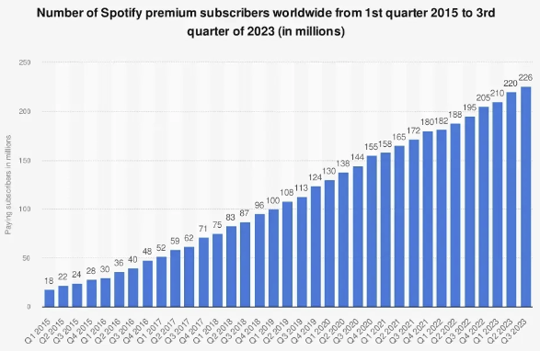
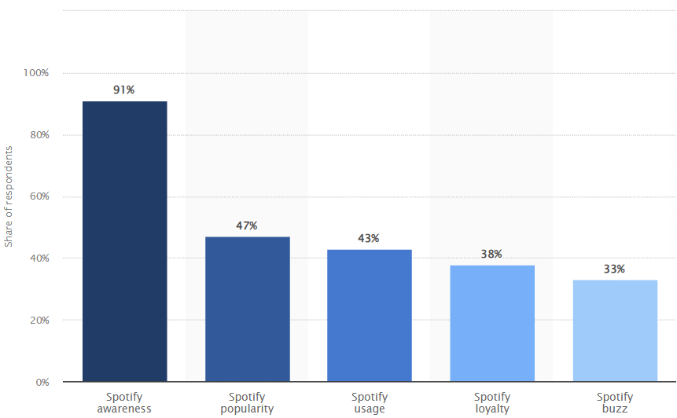
www.statista.com
Public Perception Analysis
Spotify users have increased steadily over the past 4 years
Spotify awareness
Notes:
Spotify, the popular audio streaming service, has employed an interesting pricing strategy to cater to its diverse user base. Let's delve into the details:
1. Freemium Model: Spotify initially adopted a freemium pricing model. This approach allowed basic functionality for free, while charging users for additional features such as ad-free streaming and offline music downloads².
2. Localized Pricing Optimization: Spotify goes beyond setting fixed prices in local currencies. Instead, they use market research and data to optimize pricing for each local market. By tailoring prices to suit consumers in specific countries, they reduce customer friction and build trust³.
3. Premium Price Adjustments: In 2023, Spotify made changes to its Premium prices across several markets. Existing subscribers in the US and other countries were affected by these adjustments. Here are the new prices:
- Premium Individual: $10.99 per month
- Premium Duo: $14.99 per month
- Premium Family: $16.99 per month
- Premium Student: $5.99 per month¹
4. Four Premium Account Tiers: Spotify offers four premium plans based on individual needs:
- Premium Individual: For solo listeners.
- Premium Duo: Ideal for couples or pairs.
- Premium Family: Designed for families.
- Premium Student: Tailored for students⁴.
In summary, Spotify's pricing strategy combines a freemium approach with localized optimization, ensuring a wide reach and a seamless experience for music enthusiasts worldwide. 🎶🔊

Slide 27

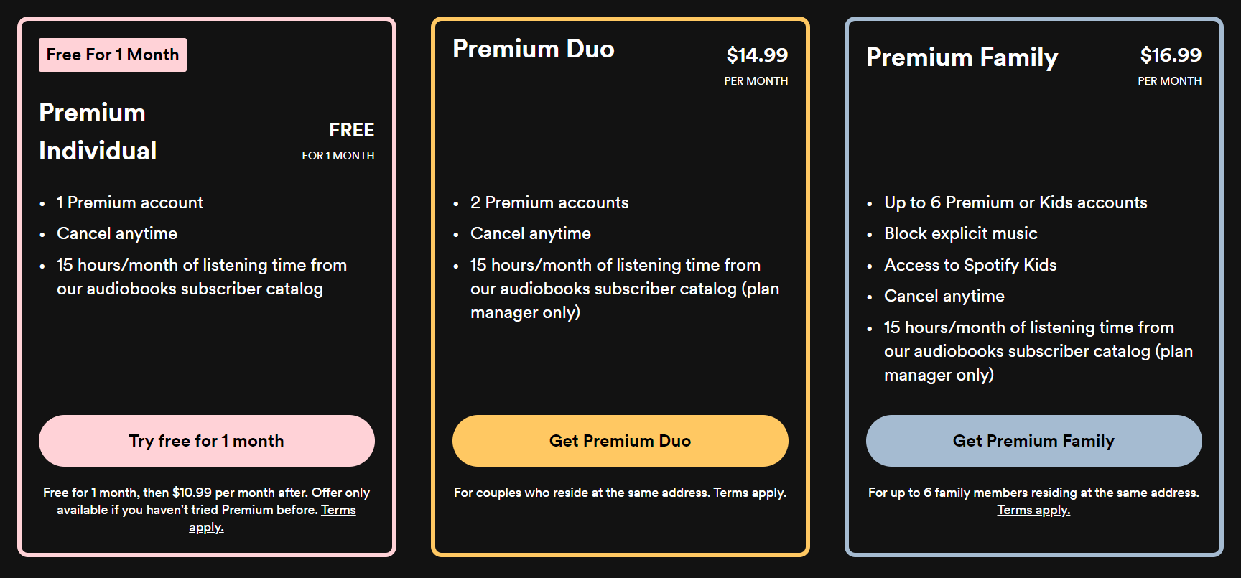

Slide 28
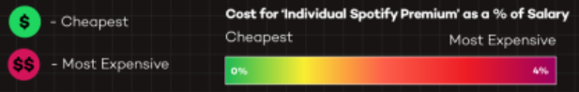
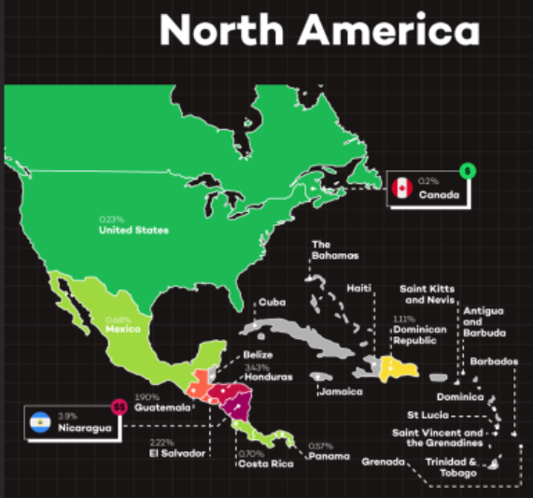
1
Freemium
2
Premium
3
Localized Pricing Optimization
Case Statement: How can we help Spotify increase and maintain their growth in growth in market share
Notes:
Spotify, the popular audio streaming service, has employed an interesting pricing strategy to cater to its diverse user base. Let's delve into the details:
1. Freemium Model: Spotify initially adopted a freemium pricing model. This approach allowed basic functionality for free, while charging users for additional features such as ad-free streaming and offline music downloads².
2. Localized Pricing Optimization: Spotify goes beyond setting fixed prices in local currencies. Instead, they use market research and data to optimize pricing for each local market. By tailoring prices to suit consumers in specific countries, they reduce customer friction and build trust³.
3. Premium Price Adjustments: In 2023, Spotify made changes to its Premium prices across several markets. Existing subscribers in the US and other countries were affected by these adjustments. Here are the new prices:
- Premium Individual: $10.99 per month
- Premium Duo: $14.99 per month
- Premium Family: $16.99 per month
- Premium Student: $5.99 per month¹
4. Four Premium Account Tiers: Spotify offers four premium plans based on individual needs:
- Premium Individual: For solo listeners.
- Premium Duo: Ideal for couples or pairs.
- Premium Family: Designed for families.
- Premium Student: Tailored for students⁴.
In summary, Spotify's pricing strategy combines a freemium approach with localized optimization, ensuring a wide reach and a seamless experience for music enthusiasts worldwide. 🎶🔊

